Slide 1
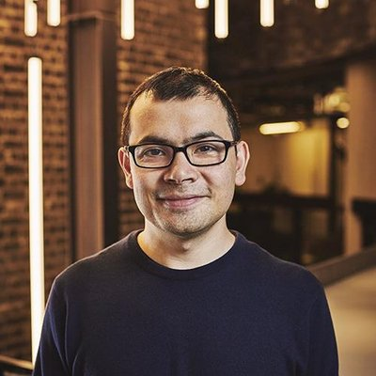


AGI strategy
This is Bob.
Bob heads an AGI R&D lab.
What should Bob do?

Slide 2

AGI strategy
This is Alice.
Alice has just been elected president of the USA.
What should Alice do about AGI?

Slide 3
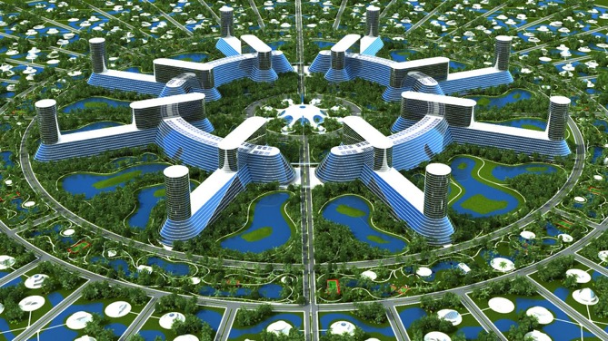
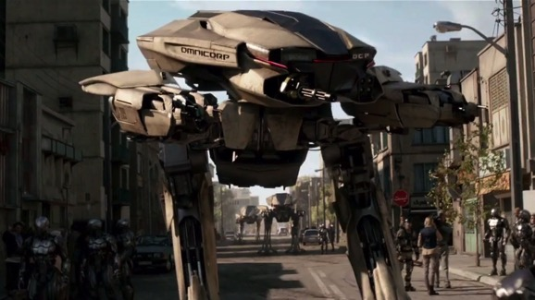

AGI futures narratives
Tech utopia
Arms race
Malicious use
Existential risk

Slide 4





How do we explore and communicate these futures?
Single author exploration

Slide 5
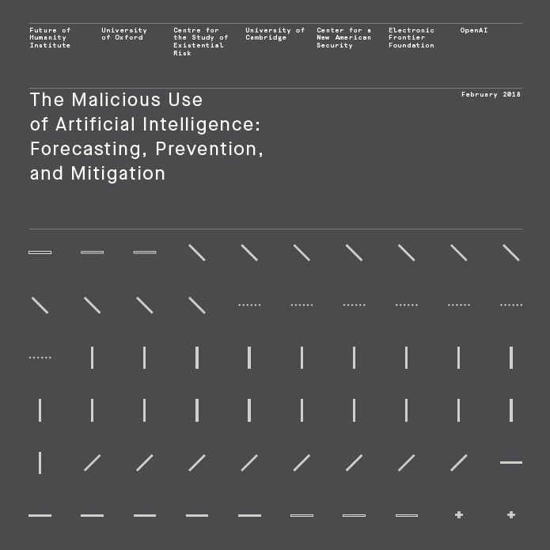
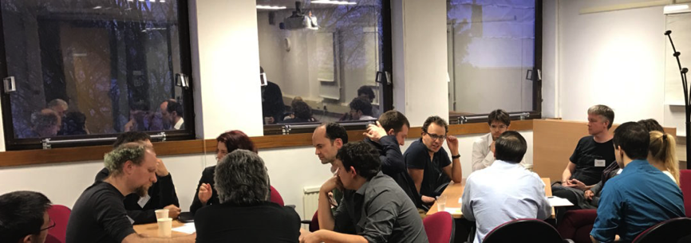
How do we explore and communicate these futures?
Expert workshops, multi-authored reports
http://maliciousaireport.com/

Slide 6
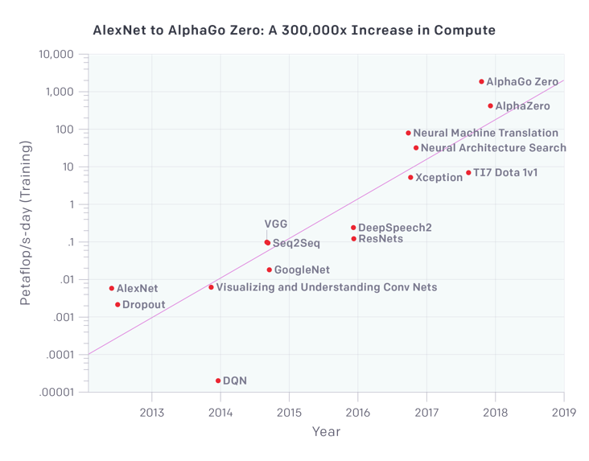
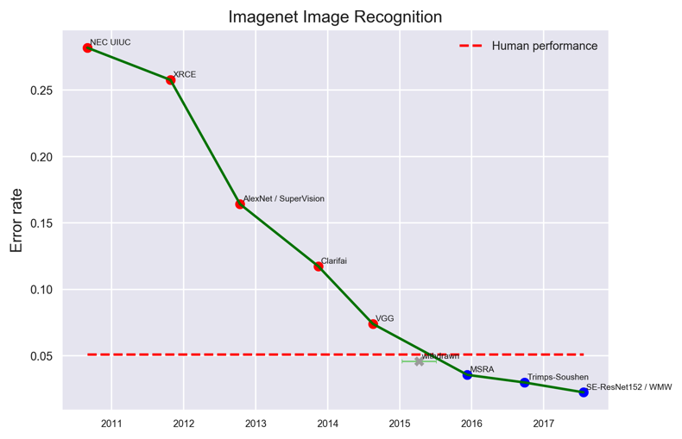
How do we explore and communicate these futures?
Data trends
https://www.eff.org/ai/metrics
https://blog.openai.com/

Slide 7
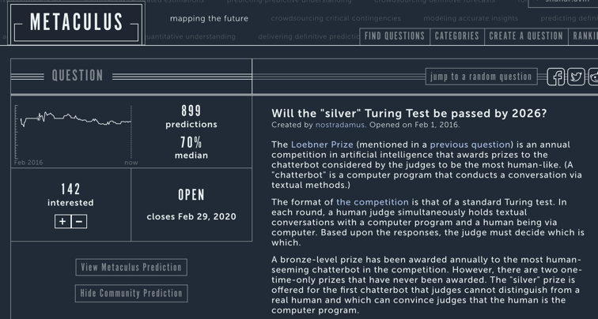
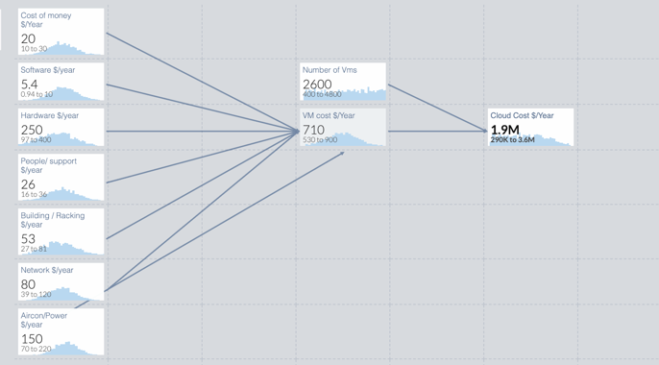
How do we explore and communicate these futures?
Aggregate probability estimates
https://www.getguesstimate.com
https://www.metaculus.com

Slide 8
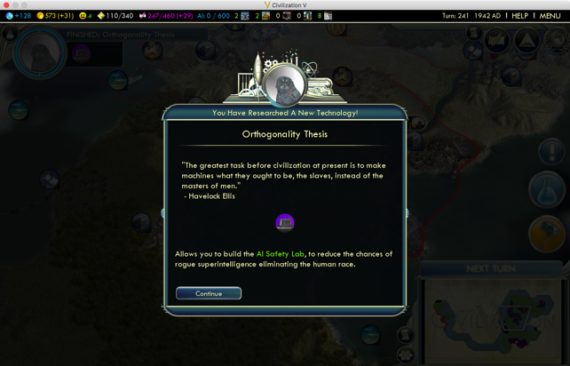
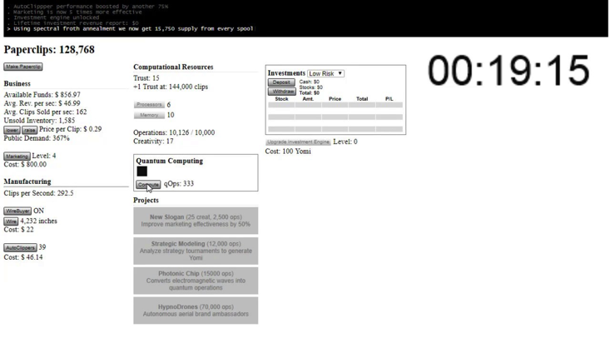
How do we explore and communicate these futures?
Video games
https://bit.ly/2uqXNUn
http://www.decisionproblem.com/paperclips/

Slide 9
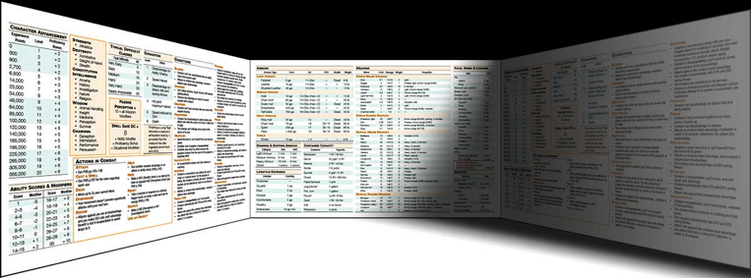


How do we explore and communicate these futures?
Scenario role-play

Slide 10
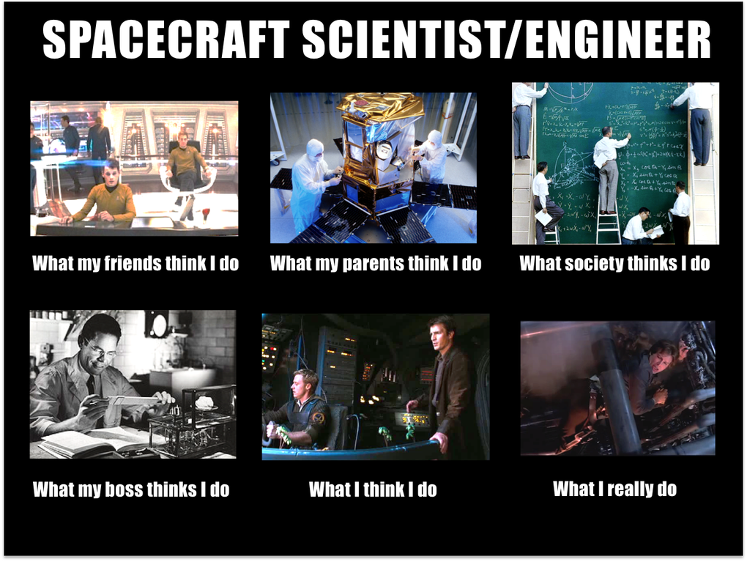

Slide 11
What should we be looking at?
Development
Deployment
Landscape

Slide 12


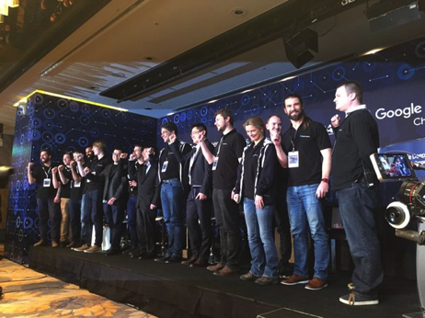
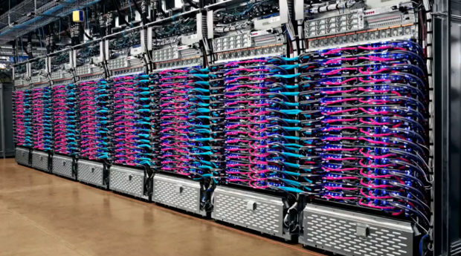
Development factors
Inputs

Slide 13
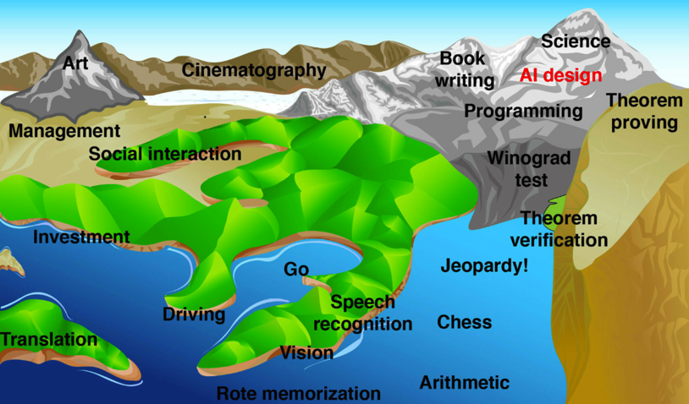
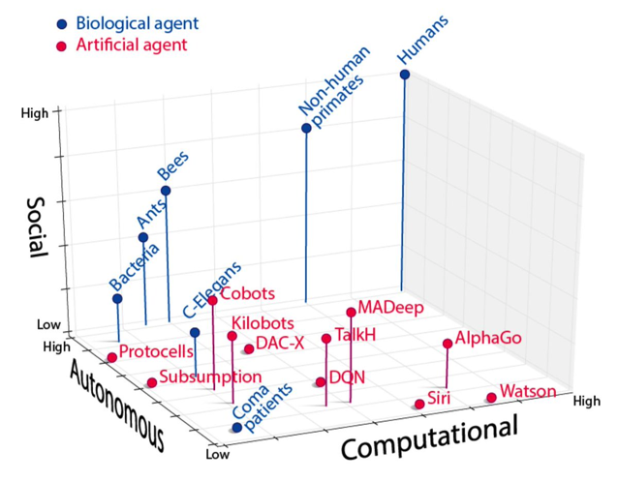
Development factors
Nature of the problem

Slide 14


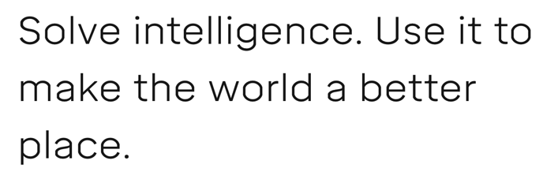
Development factors
Control, incentives, openness

Slide 15
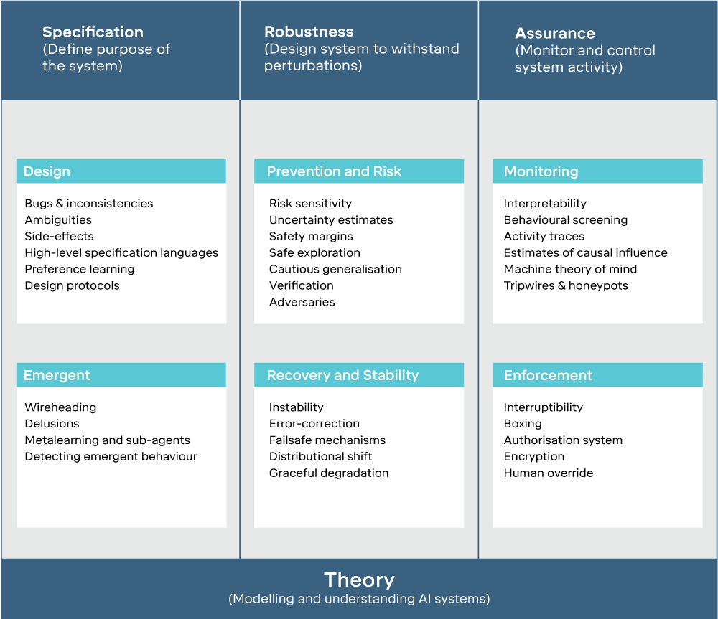
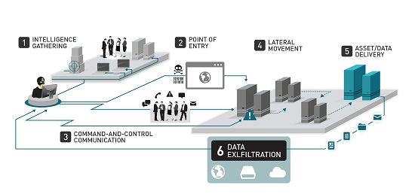
Development factors
Safety and Security

Slide 16
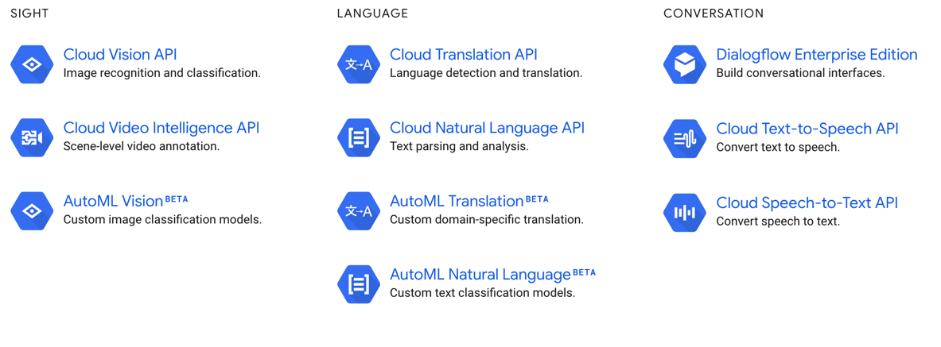
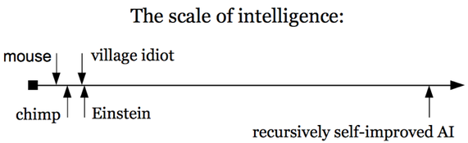
Deployment factors
All of the above (I/O, Control, Safety & Security)!
Plus: generality, capability, domains of application

Slide 17
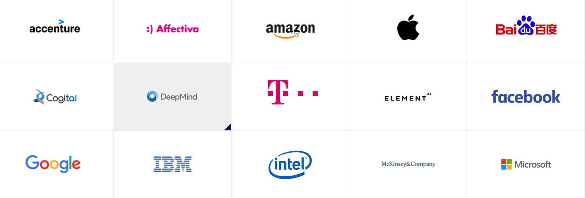
Landscape factors
Number and identity of actors

Slide 18
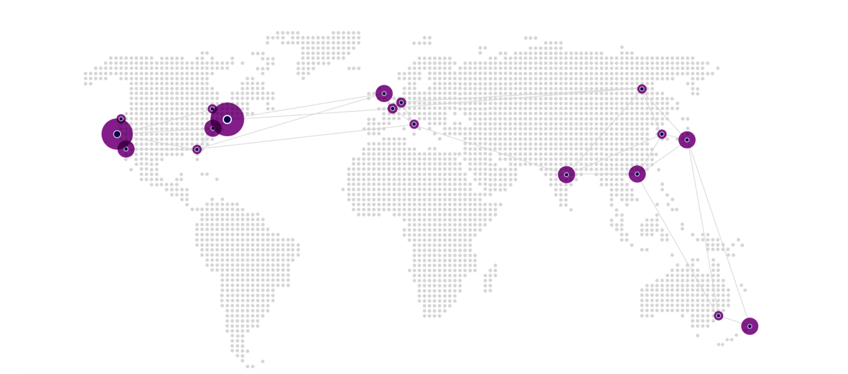
Landscape factors
Inter-actor relationships

Slide 19
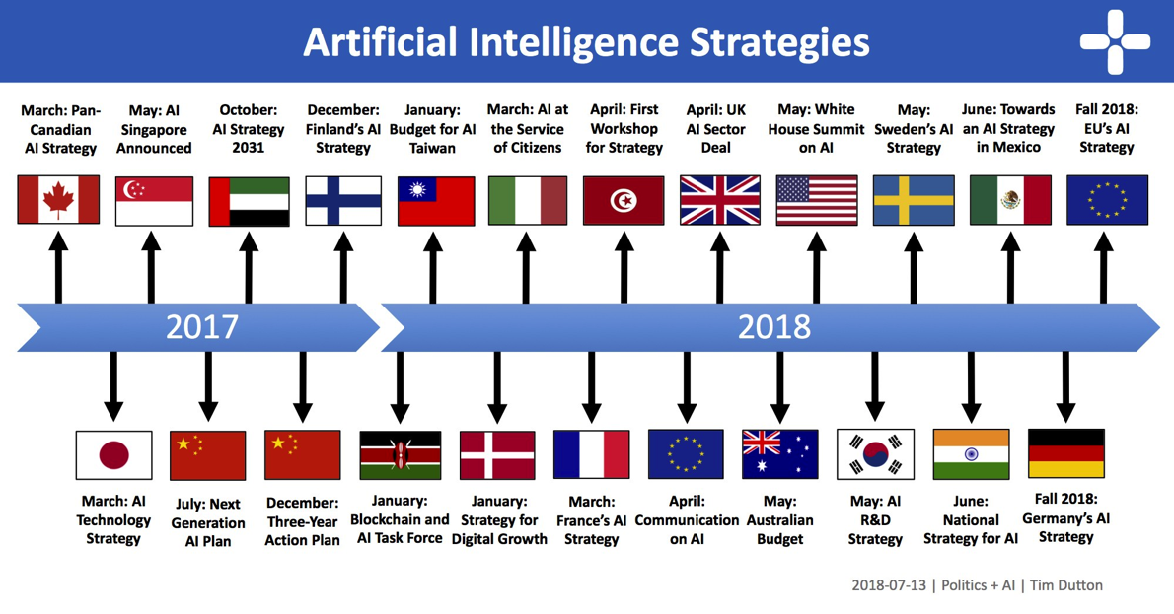
Landscape factors
International relations

Slide 20
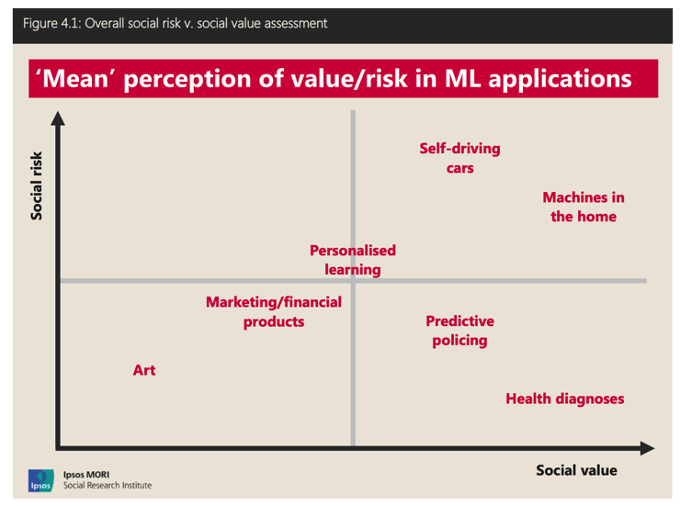


Landscape factors
Society and culture

Slide 21
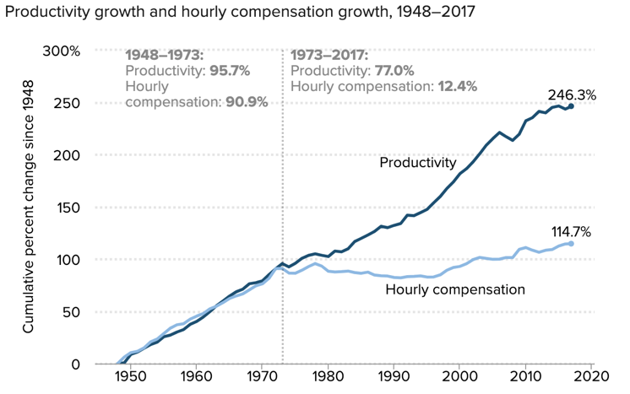
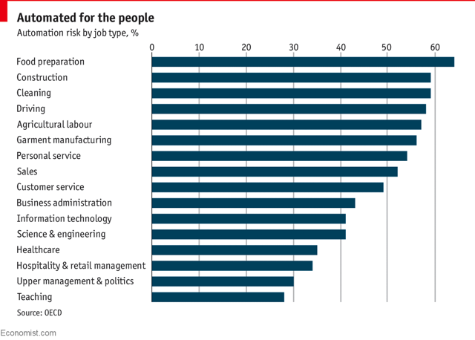
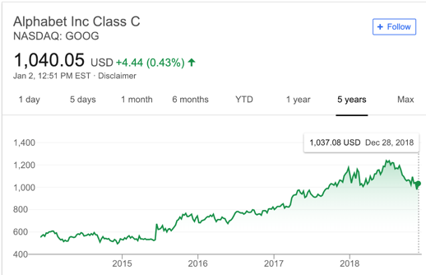
Landscape factors
The economy

Slide 22
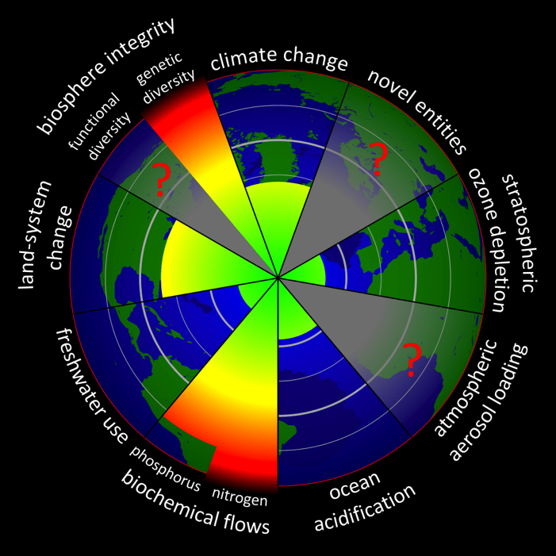
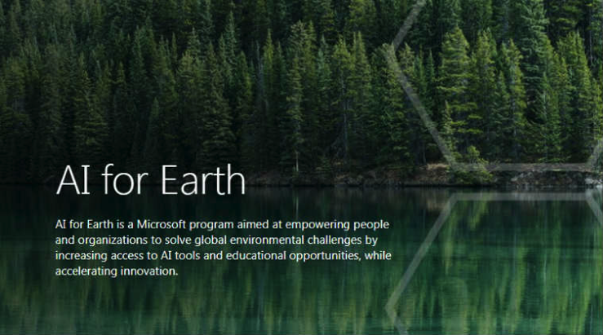
Landscape factors
The environment

Slide 23
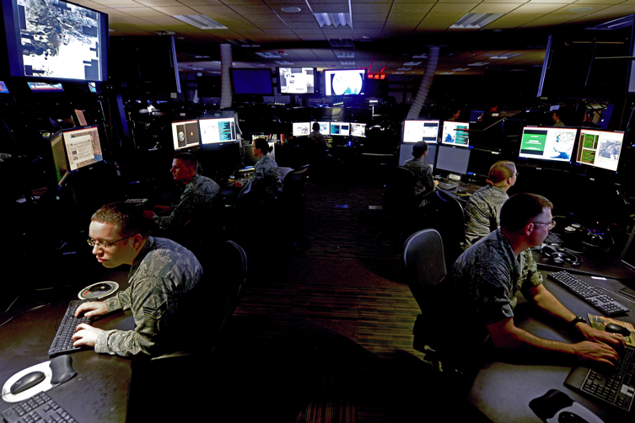
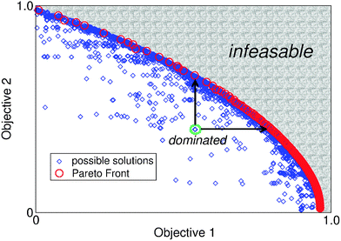
Landscape factors
Security

Slide 24
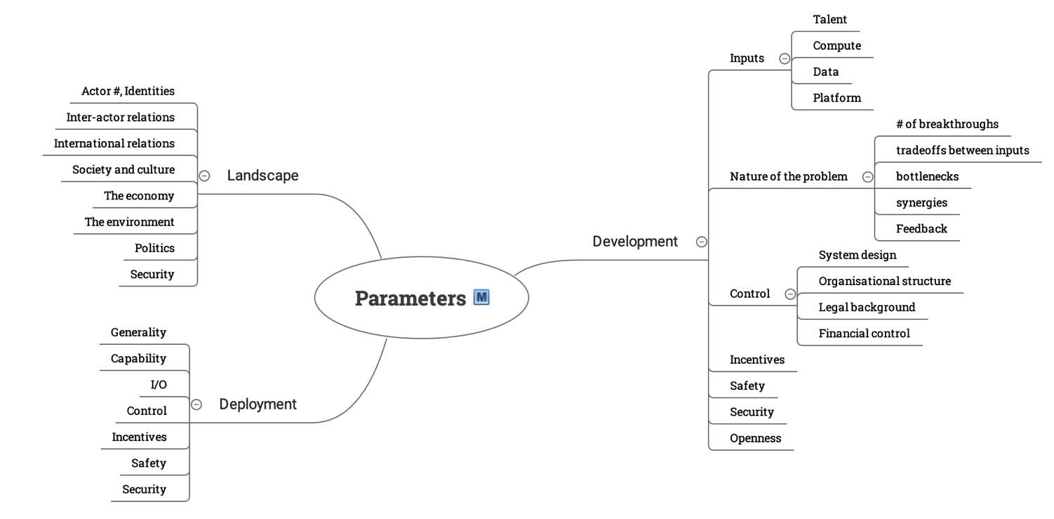

Slide 25
Different perspectives
incentives
models
generalisations
attractors
stability
identities
context
world view
salience
narrative

Slide 27
CSER AI Strategy scenario role-plays
~20 so far
3-60 participants
AI researchers, policy researchers, effective altruists, general public
Play as USG, PRC, EU, Tech company, Defence contractor, NGO
Track talent, compute, technical breakthroughs, data, money
Public and secret actions, negotiations, time pressure
Fun, if depressing at times
Get in touch if you’re interested

